Slide 1
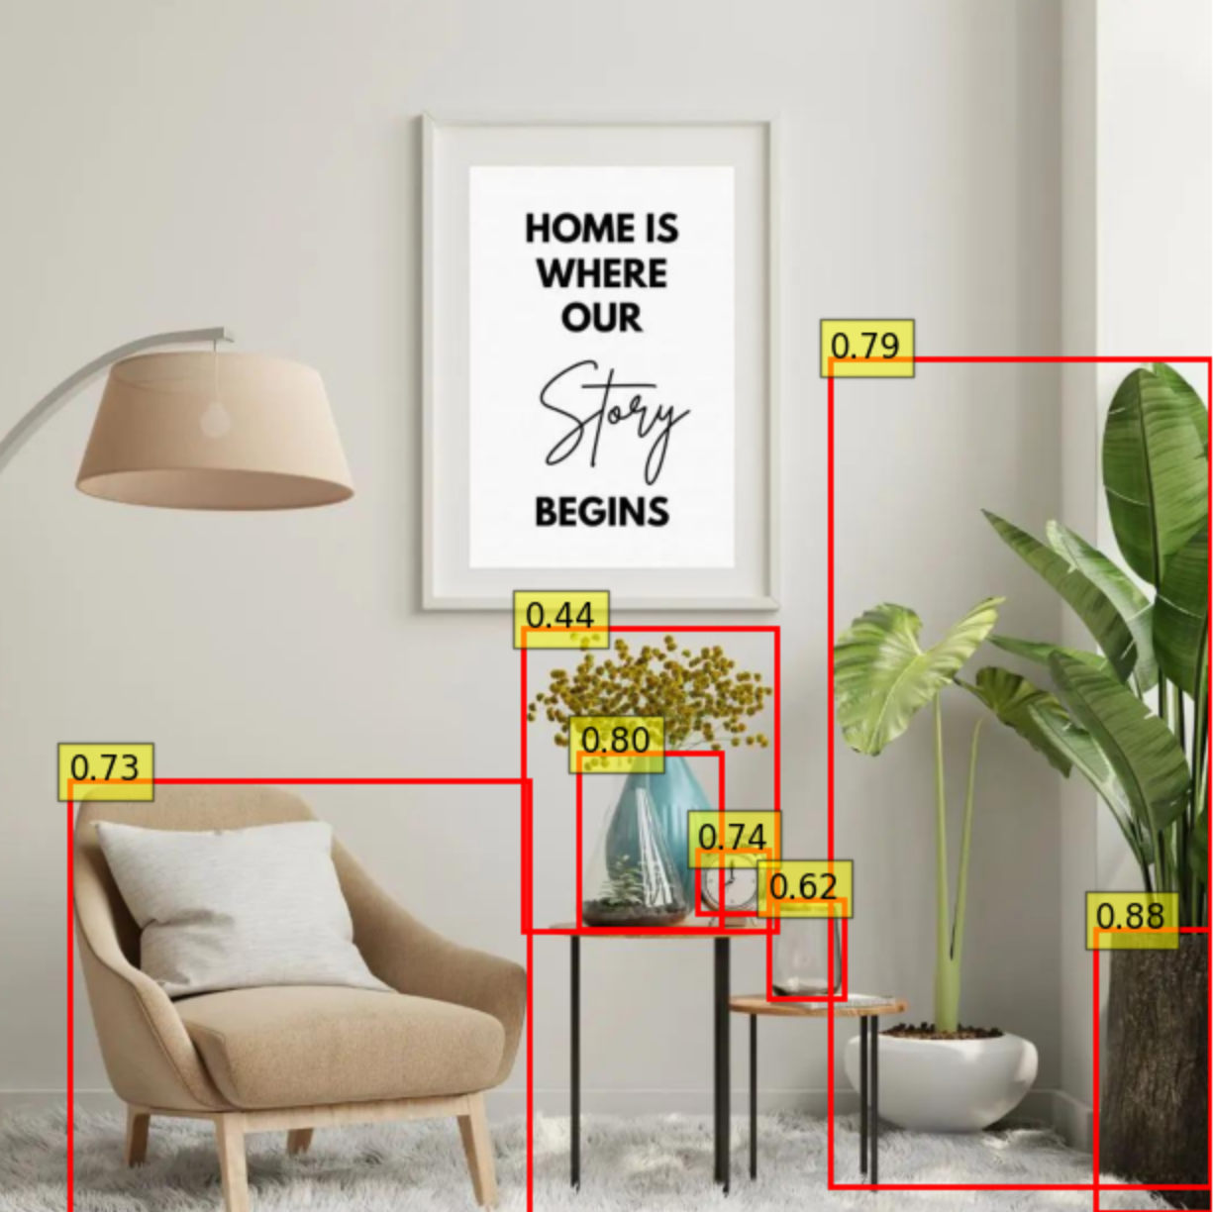

Image Segmentation, Object Identification, Text Extraction, and Summarization
Samah Syed
samahsyed2@gmail.com

Slide 2

Approach
Key Objectives
Detect and segment objects from input images.
Extract textual content from both objects and master images.
Identify and classify segmented objects using a pre-trained YOLOv5 model.
Generate a summary of object attributes and present results visually.

Slide 3






Modules and Techniques
01
02
03
04
05
Image Segmentation
Object Identification
Text Extraction
Summarization
using YOLOv5 pre-trained model
Save individual objects as images
extract metadata
using YOLOv5 pre-trained model
Map object descriptions to the segmented images
Tesseract OCR to extract text
extract text from both segmented objects and master images
summarize detected classes
summarize descriptions
dominant colors using a combination of image captioning (BLIP model) and color analysis

Slide 4
Implementation: Step-By-Step Pipeline
01
02
03
04
05
02
06
05
Data Preparation and Setup
Image Segmentation
Object Identification
Text Extraction
Summarization
Visualization
paths to the necessary directories
creation of these directories dynamically at runtime
pre-trained YOLOv5 model (yolov5l)
extract bounding boxes and save each object in SEGMENTED_OBJECTS_DIR
save metadata in a JSON file
pre-trained YOLOv5 model (yolov5l)
identified objects' names and descriptions into another JSON fil
Tesseract OCR on the segmented images and master images
Text data was saved to a JSON file
BLIP (image captioning) to generate descriptions
ColorThief to extract dominant colors
metadata, extracted text, and object descriptions into a unified summary
visualize bounding boxes and detected objects on the master images
annotated images and a summary table for each master image showing object details

Slide 5
Results

Slide 6
